Slide 1
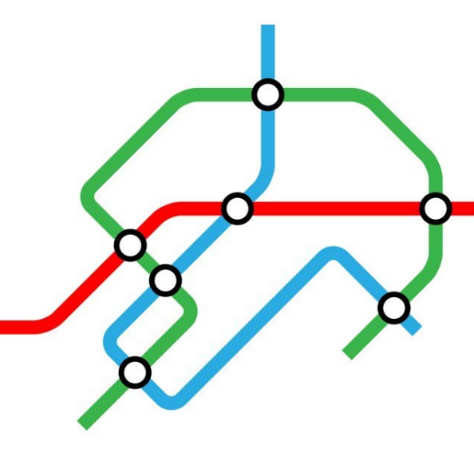
Working with Spatial Data. Network Analysis
Reading, exploring and analyzing, feature extraction
Yordan Darakchiev
Technical Trainer
iordan93@gmail.com

Slide 2
sli.do #DataScience

Slide 3
Table of Contents
Geospatial data
Reading and exploring
Projections
Visualization
Scatter plots
Choropleth maps
Network analysis
Graphs, types of graphs
Shortest path between nodes
Centrality
Communities

Slide 4
Geospatial Data
Exploring, analyzing and visualizing

Slide 5
Geospatial Data
Data that has a geographic component to it
Most commonly: coordinates (latitude, longitude)
Sometimes: country, city, ZIP code, address
Not necessarily on Earth (Google Mars)
Sources
Satellite images
GPS data
Geotagging (e.g. photos in Facebook)
Manual entry, etc.
Working with spatial data isn't trivial…
E.g. we need geometry on a sphere to calculate distances
… but we have libraries that make our lives easier

Slide 6
Reading and Exploring Geospatial Data
In some cases, we have convenient datasets
In other cases, it's in specific formats
GeoJSON, Shapefile, KML, etc.
Some libraries (like geopandas) can read these automatically
Data cleaning
Non-spatial columns: proceed as usual
Tidy up the data, impute or remove missing values, explore outliers, normalize columns, etc.
Spatial columns: fixing or changing coordinates is easier when you visualize them
Exploratory data analysis
Most commonly: look for clusters and other patterns
Also: compare attributes across different regions
E.g. income by country

Slide 7
Example: Earthquake Data
Dataset: earthquakes.csv, info
Read the dataset, look at missing values
Leave only columns you're interested in
Explore the dataset
Examples: how is the magnitude distributed? When and where did the most powerful earthquakes happen? What are the recent ones?
Perform additional data cleaning, exploration and visualization of the non-spatial columns
Fix dates (remove invalid date format, convert to datetime)
["Date", "Time", "Latitude", "Longitude", "Magnitude", "Depth"]
dt_info = earthquake_data.Date + " " + earthquake_data.Time
earthquake_data = earthquake_data.drop( index = dt_info[dt_info.str.len() > 20].index)
earthquake_data["DateTime"] = pd.to_datetime( earthquake_data.Date + " " + earthquake_data.Time)

Slide 8
Plotting Data on a Map
To plot data, we'll use the basemap package
Setting up and displaying a world map
Projections (docs)
Different ways to show a sphere in a 2D plane
Every projection has distortions
conda install –c conda-forge basemap
from mpl_toolkits.basemap import Basemap
m = Basemap(projection = "merc", llcrnrlat = -80, urcrnrlat = 80,
llcrnrlon = -180, urcrnrlon = 180)
m.drawcoastlines()
m.fillcontinents(color = "coral", lake_color = "aqua")
m.drawparallels(np.arange(-90, 91, 30))
m.drawmeridians(np.arange(-180, 181, 60))
m.drawmapboundary(fill_color = "aqua")
plt.show()

Slide 9
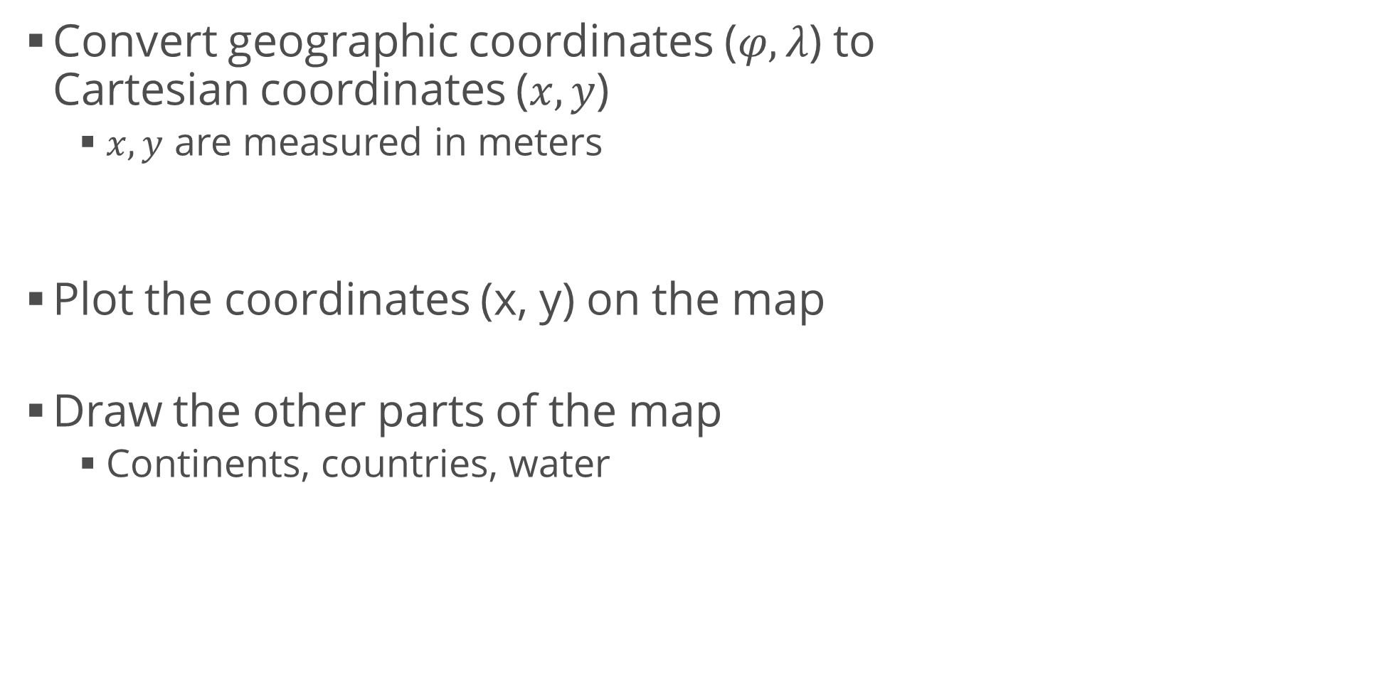
Plotting Data on a Map (2)
Convert geographic coordinates ($φ, λ$) to Cartesian coordinates ($x, y$)
$x, y$ are measured in meters
Plot the coordinates (x, y) on the map
Draw the other parts of the map
Continents, countries, water
x, y = m(earthquake_data.Longitude.tolist(), earthquake_data.Latitude.tolist())
m.plot(x, y, "o", markersize = 2, color = "red")
m.drawcoastlines()
m.drawcountries()
m.fillcontinents(color = "coral", lake_color = "aqua")
m.drawmapboundary(fill_color = "aqua")
m.drawcountries()
plt.show()

Slide 10
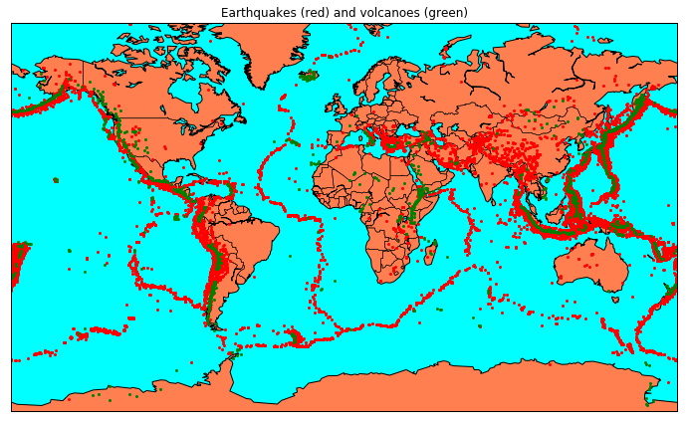
Adding Data on Volcanoes
Dataset: volcanoes.csv, info
Read the data and convert to x, y coordinates
Plot just after the earthquakes
And before the "map decorations"
x_volc, y_volc = m(volcanos_data.Longitude.tolist(), volcanos_data.Latitude.tolist())
m.plot(x_volc, y_volc, "o", markersize = 4, color = "green")

Slide 11
Drawing a Choropleth Map
Like a heatmap
Shows different countries (or US states) in different colors according to a scale
Dataset: ufo_sightings_scrubbed.csv, info
Clean the data (careful with "longitude")
Narrow down the data to US
Download the 3 shape files from here (st99_00)
ufos = pd.read_csv("ufo_sightings_scrubbed.csv", low_memory = False)
ufos = ufos[["datetime", "country", "state", "latitude", "longitude "]]
ufos.columns = ["datetime", "country", "state", "latitude", "longitude"]
ufos = ufos[ufos.country == "us"]

Slide 12
Drawing a Choropleth Map (2)
Create a map and read the shape file
Read the state names from state_names.csv
Use them to add the full names to the UFOs dataset
Get the number of sightings per state
m = Basemap(projection = "merc", llcrnrlon = -130, llcrnrlat = 23, urcrnrlon = -64, urcrnrlat = 50)
us_info = m.readshapefile("st99_d00", "states", drawbounds = True)
state_names = pd.read_csv("states.csv")
state_names.abbreviation = state_names.abbreviation.str.lower()
state_names_dict = {state.abbreviation: state["name"] for index, state in state_names.iterrows()}
ufos.state.replace(state_names_dict, inplace = True)
num_sightings_by_state = ufos.groupby("state").size()

Slide 13
Drawing a Choropleth Map (3)
Import some libraries
Set up the map and some objects to use later
import matplotlib
from matplotlib.colors import rgb2hex
from matplotlib.patches import Polygon
fig = plt.figure(figsize = (15, 10))
m = Basemap(projection = "merc", llcrnrlon = -130, llcrnrlat = 23, urcrnrlon = -64, urcrnrlat = 50)
us_info = m.readshapefile("st99_d00", "states", drawbounds = True)
colors = {}
state_names = []
cmap = plt.cm.Greens
vmin = num_sightings_by_state.min()
vmax = num_sightings_by_state.max()

Slide 14
Drawing a Choropleth Map (4)
Compute colors for each state
Using a specified color map
np.sqrt() spreads the colors more evenly
(sightings – vmin) / (vmax – vmin) returns a normalized value from 0 to 1
cmap() returns RGBA values, [:3] discards the alpha channel
for shape_dict in m.states_info:
state_name = shape_dict["NAME"]
# Skip DC and Puerto Rico
if state_name not in ["District of Columbia", "Puerto Rico"]:
sightings = num_sightings_by_state[ num_sightings_by_state.index == state_name][0]
colors[state_name] = cmap( np.sqrt((sightings - vmin) / (vmax - vmin)))[:3]
state_names.append(state_name)

Slide 15
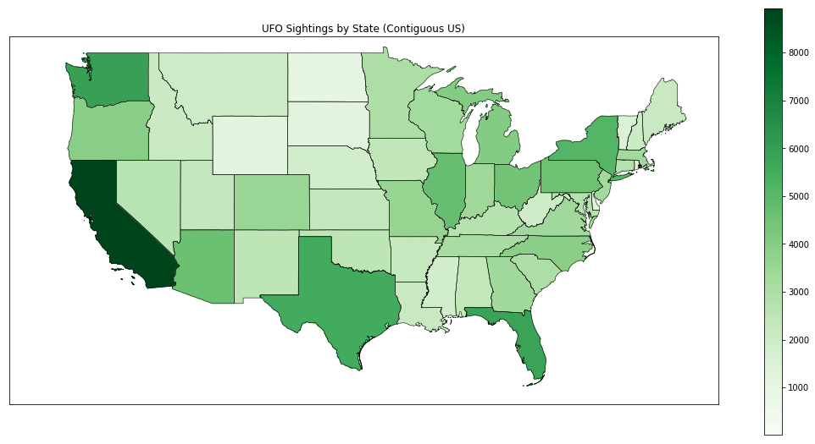
Drawing a Choropleth Map (5)
Draw the polygons for each state
Add title and color bar
ax = plt.gca()
for nshape, seg in enumerate(m.states):
# Skip DC and Puerto Rico
if state_names[nshape] not in ["District of Columbia", "Puerto Rico"]:
color = rgb2hex(colors[state_names[nshape]])
poly = Polygon(seg, facecolor = color, edgecolor = color)
ax.add_patch(poly)
plt.title( "UFO Sightings by State (Contiguous US)")
colorbar_ax = fig.add_axes( [0.95, 0.15, 0.02, 0.7])
matplotlib.colorbar.ColorbarBase( colorbar_ax, cmap = cmap,
norm = matplotlib.colors.Normalize( vmin, vmax))
plt.show()

Slide 16
Analyzing Maps
There are many algorithms used to model spatial data
Most commonly, we look for density patterns and clusters of points
Common algorithms are
KDE – Kernel Density Estimation
kMeans Clustering
Hierarchical Clustering
kNN – k Nearest Neighbors
This course doesn't deal with modelling, so we won't get into more detail
But feel free to explore the algorithms as you wish
You can see details on these on machine learning-related articles
We can also represent the map as a network
E.g. road maps, railway maps, or other "sets of connected dots"

Slide 17
Network Analysis
Working with graphs

Slide 18
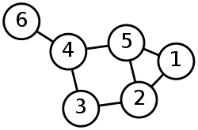
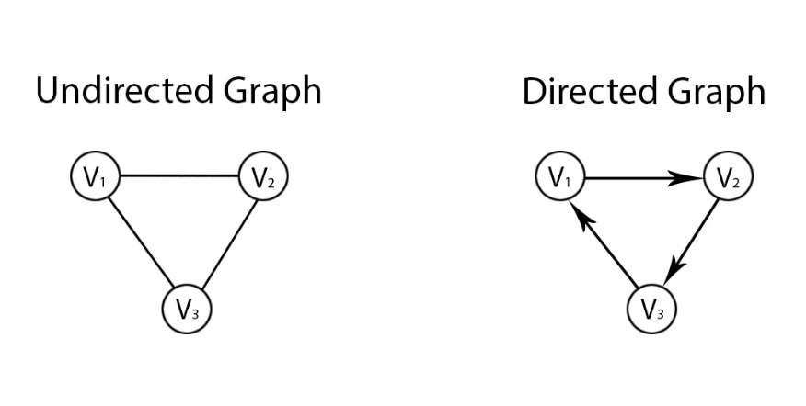
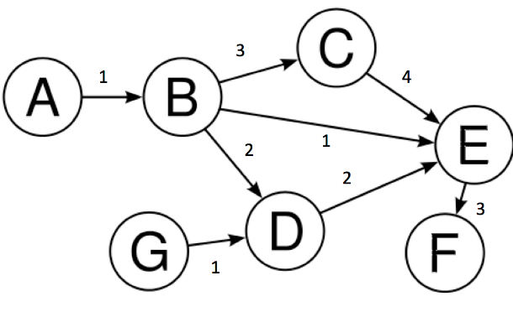
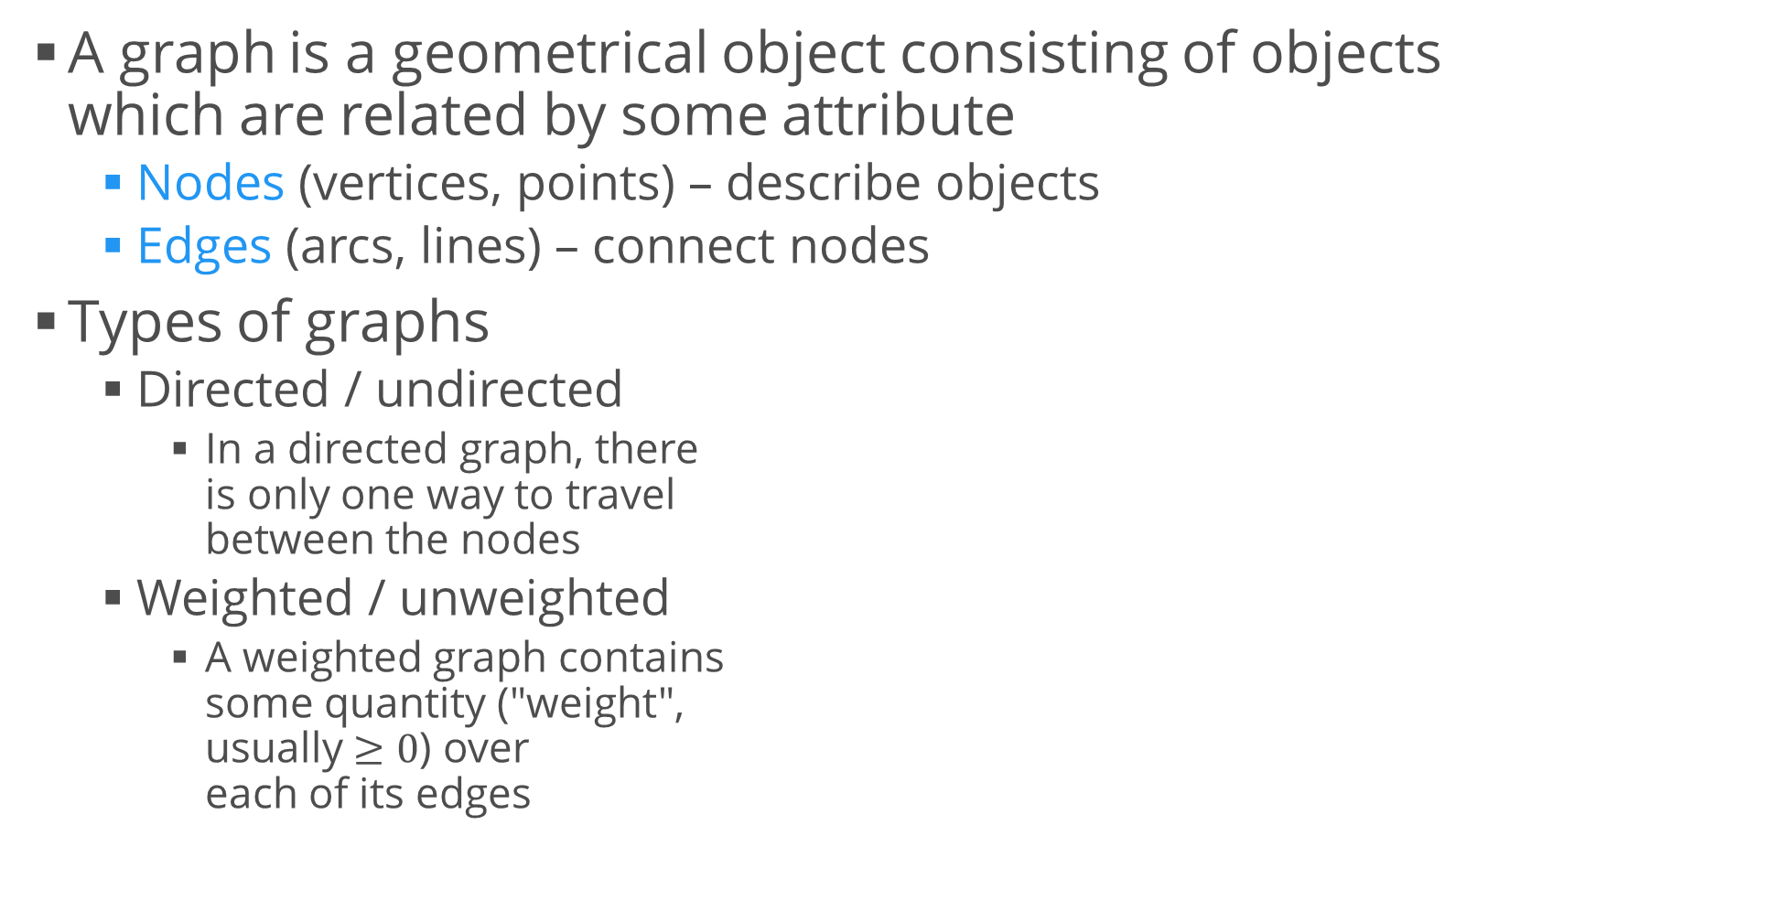
Networks = Graphs
A graph is a geometrical object consisting of objects which are related by some attribute
Nodes (vertices, points) – describe objects
Edges (arcs, lines) – connect nodes
Types of graphs
Directed / undirected
In a directed graph, there is only one way to travel between the nodes
Weighted / unweighted
A weighted graph contains some quantity ("weight", usually $≥0$) over each of its edges

Slide 19
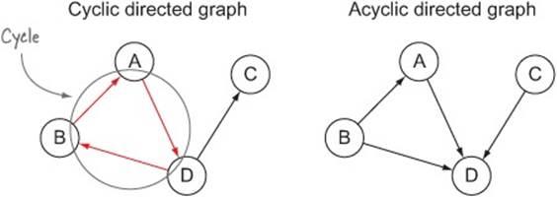
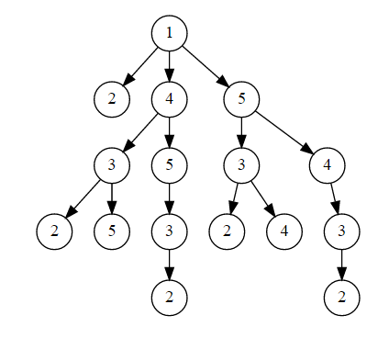
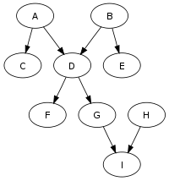
Graphs
Types of graphs (cont'd)
Cyclic / acyclic
When you travel along a cyclic graph, you will visit one node more than once
These types are independent
i.e. a graph can be “acyclic directed unweighted graph”
Special cases
Tree – each node has at most one "parent"
DAG – directed acyclic graph

Slide 20
Representing Graphs
We can use the library networkx
Installed by default with Anaconda
Create a simple weighted undirected graph
Display the graph
import networkx as nx
g = nx.Graph()
g.add_edge("a", "b", weight = 0.1)
g.add_edge("b", "c", weight = 1.5)
g.add_edge("a", "c", weight = 1.0)
g.add_edge("c", "d", weight = 2.2)
nx.draw(g, with_labels = True)
plt.show()

Slide 21
Finding a Shortest Path
Advanced graph display
Show the weights at each edge
Make the edge width proportional to its weight
Shortest paths
pos = nx.spring_layout(g)
weights = nx.get_edge_attributes(g, "weight")
nx.draw(g, pos, with_labels = True)
nx.draw_networkx_edge_labels(g, pos, edge_labels = weights)
nx.draw_networkx_edges(g, pos, width = [v * 2 for v in weights.values()])
plt.show()
print(nx.shortest_path(g, "b", "d"), nx.shortest_path_length(g, "b", "d"))
print(nx.shortest_path(g, "b", "d", weight = "weight"), nx.shortest_path_length(g, "b", "d", weight = "weight"))

Slide 22
Creating Directed Graphs
Directed graph (digraph)
Simply change the definition of g
Now each edge is directed
The visualization will include arrows
They point at the direction of each connection
g = nx.DiGraph()
g.add_edge("a", "b", weight = 0.1)
g.add_edge("b", "c", weight = 1.5)
g.add_edge("a", "c", weight = 1.0)
g.add_edge("c", "d", weight = 2.2)
print(nx.shortest_path(g, "b", "d")) # ['b', 'c', 'd']
print(nx.shortest_path(g, "d", "b")) # Error: No path between d and b.

Slide 23
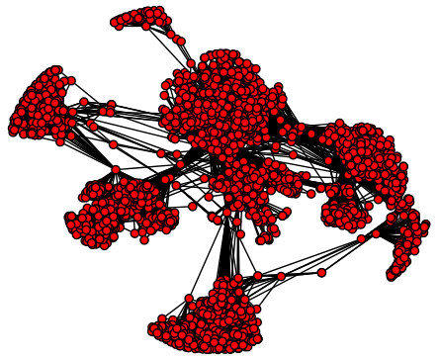
Example: Social Circles
Dataset: facebook.zip, info
Format: first_user_id second_user_id
I.e. edge list
Read the graph
Extremely simple
facebook_graph = nx.read_edgelist("facebook_combined.txt")
print(len(facebook_graph.nodes)) # 4039
print(len(facebook_graph.edges)) # 88234

Slide 24
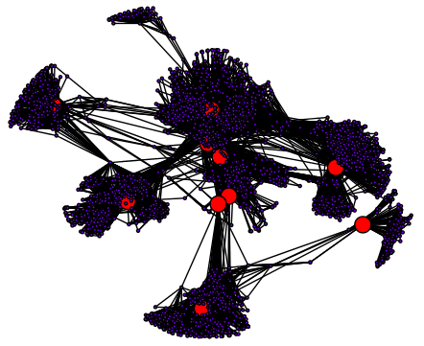
Calculating Important Nodes
Measure: centrality
Different types of centrality, according to different formulas
E.g. "betweenness centrality"
Measures how important a node is
To exemplify, let’s use a smaller graph
Ten most important nodes in the Facebook graph
Look similar to cluster centroids
karate_graph = nx.karate_club_graph()
centrality = nx.betweenness_centrality(karate_graph)
# Returns a dictionary

Slide 25
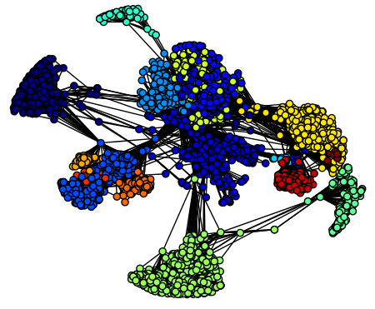
Finding Communities
Measure: cliques
Most commonly used algorithm: Girvan – Newman
Uses edge betweenness as the measure
We can find communities in the Facebook graph
Look similar to different clusters
from networkx.algorithms import community
nx.draw(karate_graph, with_labels = True)
communities_generator = community.girvan_newman(karate_graph)
for i in range(1, 4):
communities = next(communities_generator)
print("level " + str(i), communities)

Slide 26
Summary
Geospatial data
Reading and exploring
Projections
Visualization
Scatter plots
Choropleth maps
Network analysis
Graphs, types of graphs
Shortest path between nodes
Centrality
Communities

